Slide 1


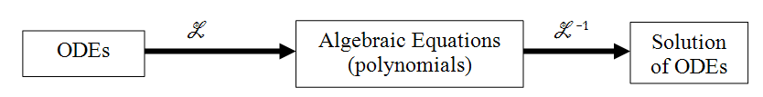
Laplace Transforms

Slide 2
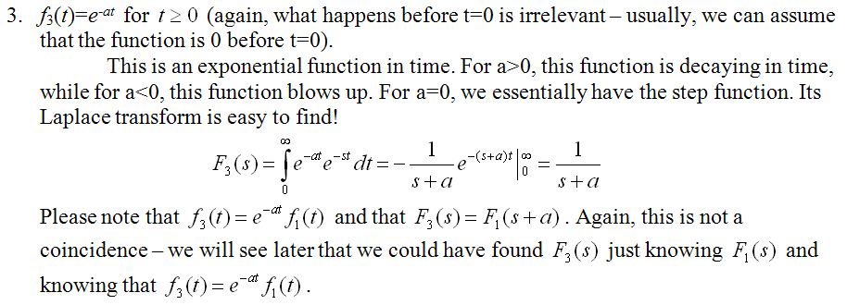
Basic Laplace Transforms

Slide 3
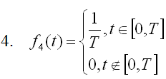
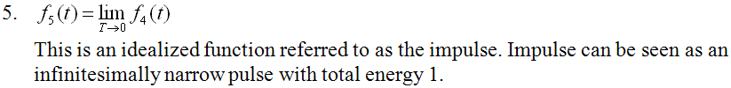

Basic Laplace Transforms

Slide 4



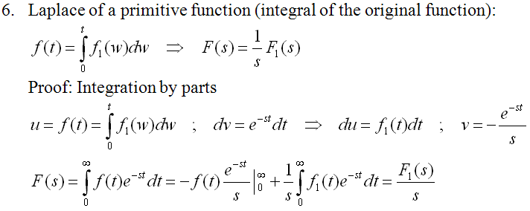
Properties of Laplace Transforms
1.
2.
3.
4.

Slide 5
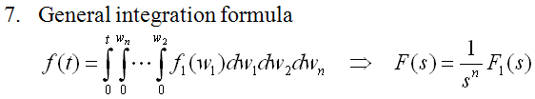

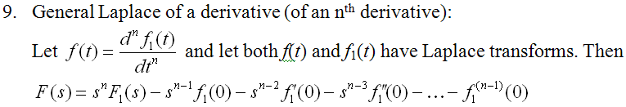
Properties of Laplace Transforms
5.
6.
7.

Slide 6
Transfer Functions of Dynamic Systems
Transfer function of a Linear Time-Invariant (LTI) system (i.e. system, whose inputs and outputs are related by a linear ordinary differential equation with constant coefficients) is ratio of Laplace Transforms of system output and system input for all initial conditions equal to zero.
All initial conditions equal to zero

Slide 7
Transfer Function for the Mass-Spring-Damper System
x (position of the mass relative to undeformed spring)
Free Body Diagram?
k
Initial conditions
m
F (external input into the system)
b

Slide 8
Connection Between the Impulse Response and the Transfer Function
Finding zero-initial-condition responses of LTI systems using Transfer functions is straight forward
Impulse Response

Slide 9
Inverse Laplace Transforms of “Proper” Rational Functions
Poles of a Laplace Transform
Let
and let
be roots of the polynomial
. Then
are referred to as the poles of the
Laplace transform Y(s).
Find poles of

Slide 10
Inverse Laplace Transforms of “Proper” Rational Functions
Case of distinct poles
and all poles are and distinct i.e.
Then
where

Slide 11
Solving Linear Differential Equations with Constant Coefficients using Laplace Transforms
F_{d} = bv
F_{μ}
F_{d}
F_{μ}= μN= μmg cos(α)
v
v(0)=v₀
mg
α
-1

Slide 12
Solving Linear Differential Equations with Constant Coefficients using Laplace Transforms
x
m=1 kg
b=7 Ns/m
k=12N/m
x₀=2m
v₀=-11m/s
b
m
k
-1
What kind of a function is this?

Slide 13
Inverse Laplace Transforms of “Proper” Rational Functions
Case of repeated poles (multiplicity k)
Then
where
…

Slide 14
Inverse Laplace Transforms of “Proper” Rational Functions
Case of repeated poles (multiplicity k)
Then
…

Slide 15

Inverse Laplace Transforms of “Proper” Rational Functions
?

Slide 16
Case of Distinct Complex Conjugate Poles
and all poles are and distinct i.e.
and
We still have that
where
but
We must group terms with poles p₁ and p₂ together to get something we know.

Slide 17
Case of Distinct Complex Conjugate Poles
-1

Slide 18
Example with Distinct Complex Conjugate Poles
What kind of a function is this?

Slide 19
Solving Linear Differential Equations with Constant Coefficients using Laplace Transforms
x
m=1 kg
b=2 Ns/m
k=10N/m
x₀=2m
v₀=-11m/s
b
m
F(t)
k

Slide 20
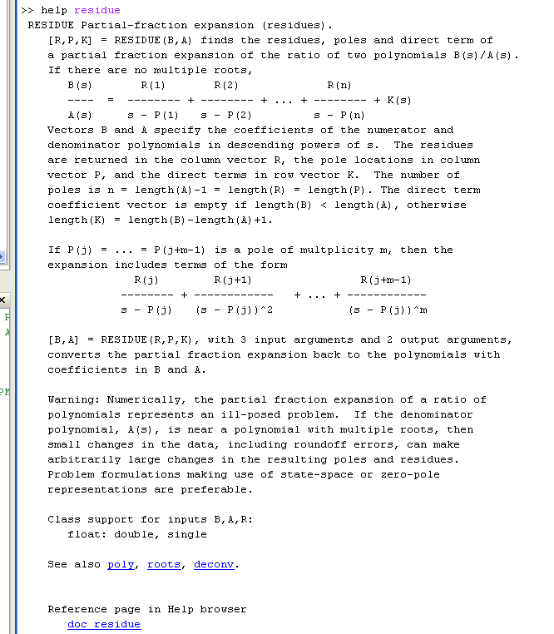
Matlab Function “residue”

